Slide 1
IIT Bombay EV Locator App
Subtitle: Tracking Electric Vehicles (Buggy) on Campus
Presented by: Arijeet Mondal [24M0812] ,
Ashu Raj [24M0820] ,
Tejas Shinde [24M0827]]

Slide 2
Overview
An innovative mobile application for IIT Bombay to track electric vehicles (EVs) on campus.
Enables users to find the nearest EVs, view routes, and get estimated arrival times.
Aims to enhance mobility and availability of EVs on campus.

Slide 3
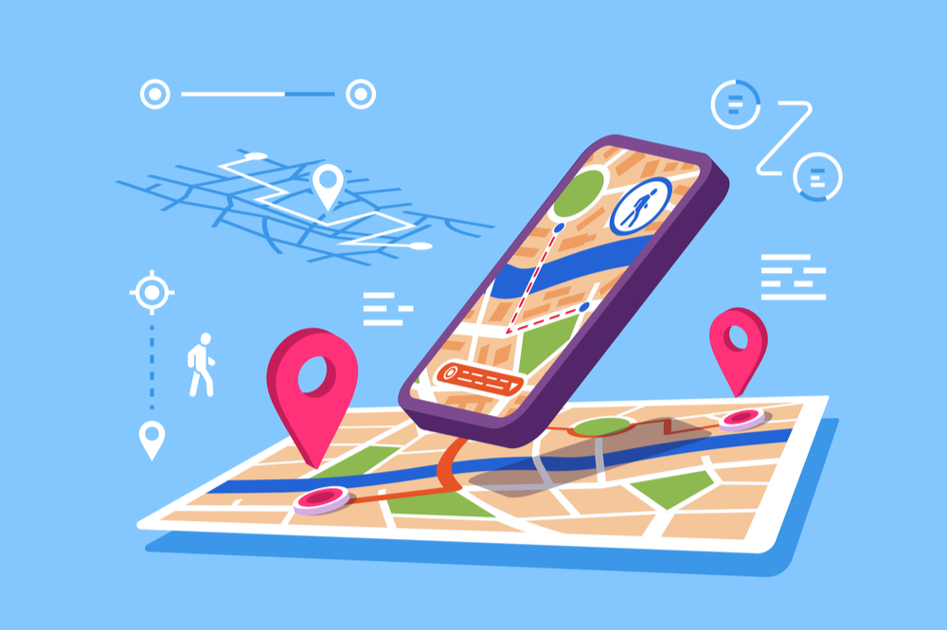
Geo Location
Map Integration:
Utilize Google Maps API for real-time location tracking.
Users can see the current location of all EVs on a campus map.
Functionality:
GPS tracking for accurate location data.
View routes of available EVs to enhance user experience.

Slide 4

User Types
User:
Students and staff seeking transportation.
Can view nearby EVs, their routes, and see ETAs.
Caddy/Buggy (Driver):
Operates the EVs on campus.
Can update their status (seats available/busy) and manage routes.

Slide 5

Backend Server
Server Architecture:
Cloud-based server to handle requests and data storage.
RESTful API for communication between the app and the server.
Technologies:
Node.js/Express for server-side logic.
Some database.

Slide 6

Time Efficient Database
Database Design
Use of NoSQL (e.g., MongoDB) for flexible data storage.
Efficient queries to minimize response times.
Data management
Store different routes of EVs.
Store current EV locations.
Implement caching strategies for frequently accessed data.

Slide 7
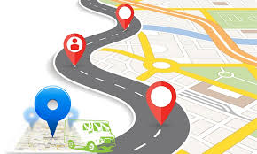
Display Route & Time Estimation
Route Display:
Real-time route visualization for users to see EV paths.
Highlight the closest EV route to the user’s location.
ETA Calculation:
Implement algorithms to estimate time based on traffic, distance, and EV speed.
Display real-time updates on estimated arrival times.

Slide 8

Availability & Payment
Availability Status:
Caddies can indicate if they are full or available via the app.
Users can filter by available caddies for a better experience.
Payment Integration:
Seamless in-app payment options (e.g., UPI, credit/debit cards).
Ensures secure transactions for users booking rides.

Slide 9

User Interface Design
UI/UX Considerations:
Intuitive design for easy navigation.
Clear icons and visual cues for users and caddies.
Screens to Include:
Home screen with map and nearby EVs.
Payment settings.

Slide 10
Conclusion
The IIT Bombay EV Locator App is designed to enhance campus mobility.

